Slide 1

FINAL PROJECT
MEIJUAN Long

Slide 2
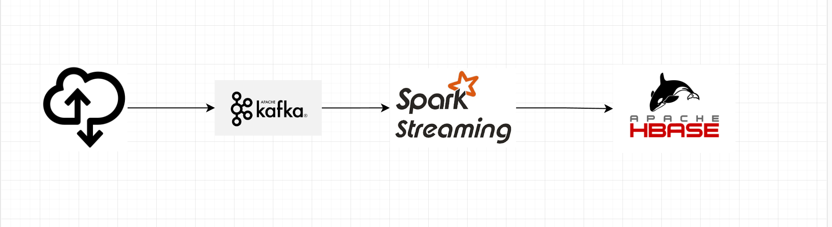
Data Flow Diagram

Slide 3
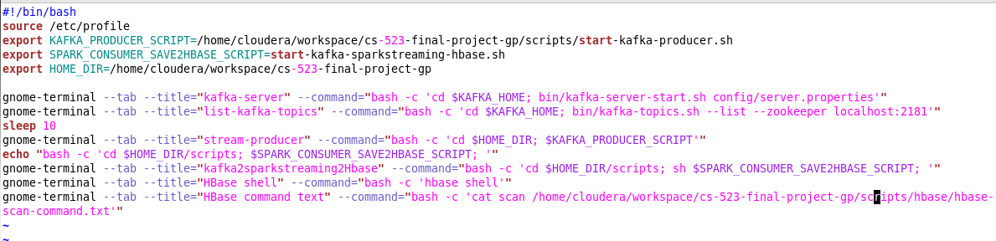
Start-demo script

Slide 4
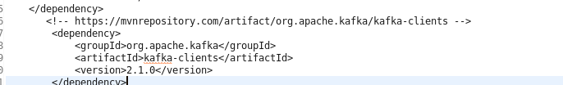
PART-3 preview
Execute command:
Add dependency pom.xml

Slide 5
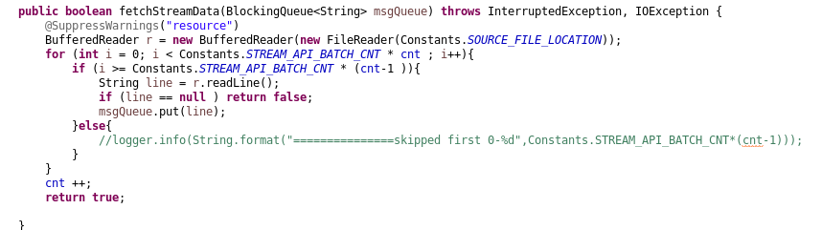
Part-3 kafka_demo
Code-RealTimeProducer.java

Slide 6
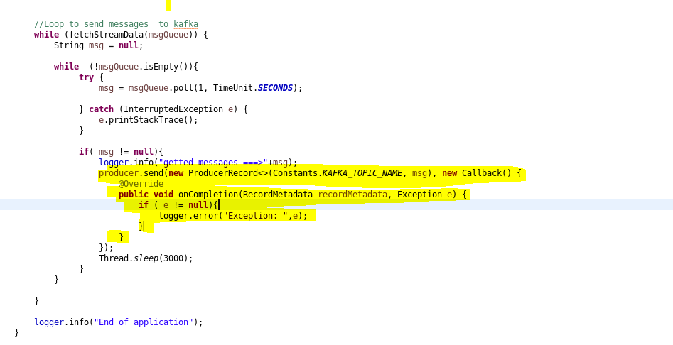
PART-3 kafka_demo
Code-RealTimeProducer.java

Slide 7
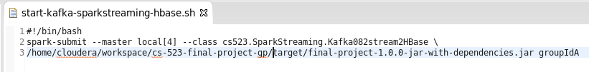
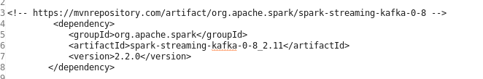
PART-1-preview
Execute commands
Dependecy pom.xml

Slide 8
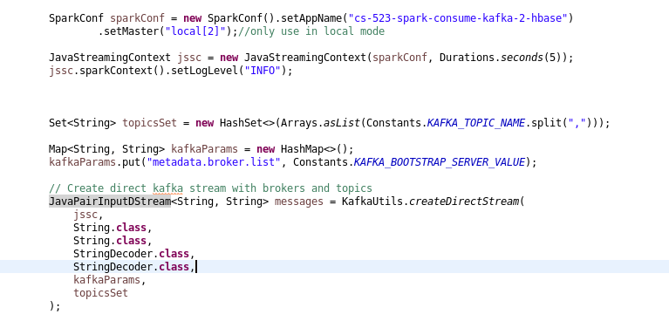
PART-1-data ingestion
Code Kafka082stream2HBase.java
Comsumer kafka topic

Slide 9
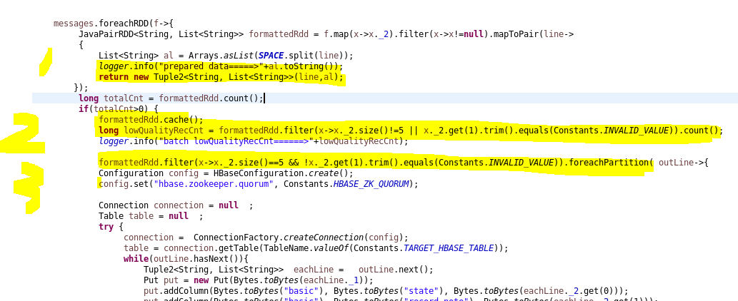
PART-1-Analysis Algorithm
Code Kafka082stream2HBase.java

Slide 10
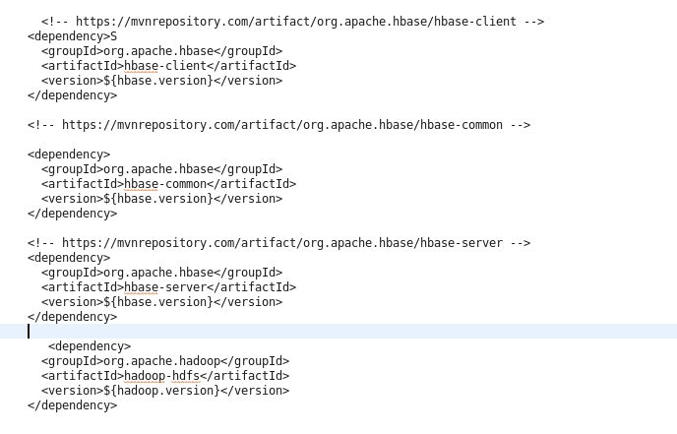
PART-2 Integrate HBase
Execute commands
Dependency pom.xml

Slide 11
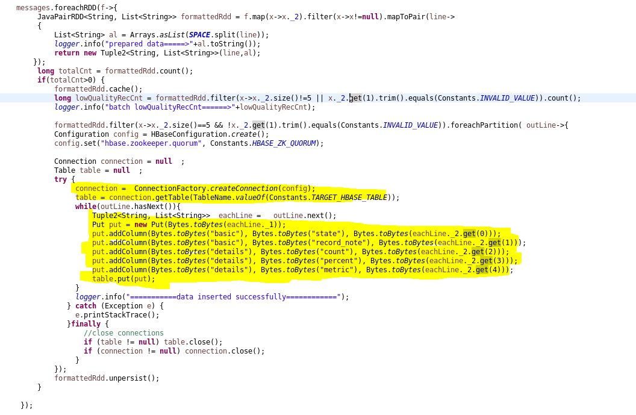
PART-2 Integrate HBase
Execute commands

